Slide 1

Advanced
Tables

Slide 2
Spanning Rows and Columns
So far, our tables have been relatively simple, with a uniform grid of rows and columns:
XHTML allows us to create more complex table elements by spanning multiple rows or columns, like this:
Let's build some tables using each of these features and then try combining both features into the same table.

Slide 3
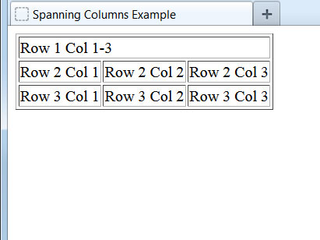
Example: Spanning Columns
We can build a data cell that spans more than one column by using the colspan attribute:
<table border="1">
<tr>
<td colspan="3">Row 1 Col 1-3</td>
</tr>
<tr>
<td>Row 2 Col 1</td>
<td>Row 2 Col 2</td>
<td>Row 2 Col 3</td>
</tr>
<tr>
<td>Row 3 Col 1</td>
<td>Row 3 Col 2</td>
<td>Row 3 Col 3</td>
</tr>
</table>
The value placed in the colspan attribute informs the browser how many columns to combine into a single data cell.

Slide 4
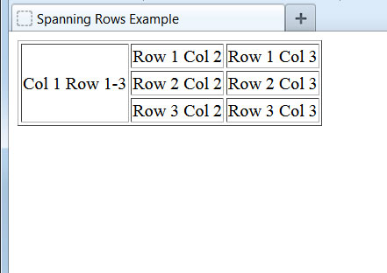
Example: Spanning Rows
Using the same principle, we can build a data cell that spans more than one row by using the rowspan attribute:
<table border="1">
<tr>
<td rowspan="3">Col 1 Row 1-3</td>
<td>Row 1 Col 2</td>
<td>Row 1 Col 3</td>
</tr>
<tr>
<td>Row 2 Col 2</td>
<td>Row 2 Col 3</td>
</tr>
<tr>
<td>Row 3 Col 2</td>
<td>Row 3 Col 3</td>
</tr>
</table>
The rowspan attribute works the same way by informing the browser how many rows to combine into a single cell.

Slide 5
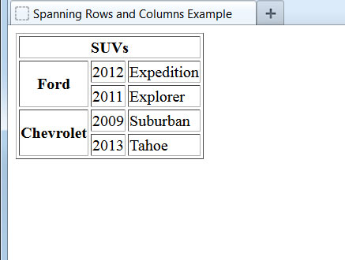
Example: Spanning Rows and Columns
<table border="1">
<tr>
<th colspan="3">SUVs</th>
</tr>
<tr>
<th rowspan="2">Ford</th>
<td>2012</td>
<td>Expedition</td>
</tr>
<tr>
<td>2011</td>
<td>Explorer</td>
</tr>
<tr>
<th rowspan="2">Chevrolet</th>
<td>2009</td>
<td>Suburban</td>
</tr>
<tr>
<td>2013</td>
<td>Tahoe</td>
</tr>
</table>
Both the colspan and rowspan features can be used in the same table to create a more complex table structure.
Notice that these two attributes can also be applied to table header elements, as we did in this example.

Slide 6
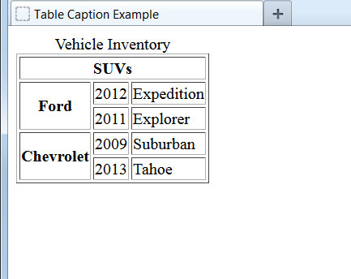
Adding a Table Caption
<table border="1">
<caption>Vehicle Inventory</caption>
<tr>
<th colspan="3">SUVs</th>
</tr>
<tr>
<th rowspan="2">Ford</th>
<td>2012</td>
<td>Expedition</td>
</tr>
<tr>
<td>2011</td>
<td>Explorer</td>
</tr>
...
</table>
To add a caption to the table, we use the <caption> element immediately after the opening <table> tag. The text enclosed within the <caption> element will be displayed above the table and centered.

Slide 7
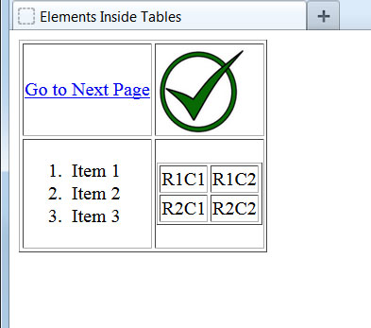
Other Elements Inside Tables
<table border="1">
<tr>
<td>
<p><a href="page2.html">Go to Next Page</a></p>
</td>
<td>
<img src="check.jpg" alt="check mark" />
</td>
</tr>
<tr>
<td>
<ol>
<li>Item 1</li>
<li>Item 2</li>
<li>Item 3</li>
</ol>
</td>
<td>
<table border="1">
<tr>
<td>R1C1</td><td>R1C2</td>
</tr>
<tr>
<td>R2C1</td><td>R2C2</td>
</tr>
</table>
</td>
</tr>
</table>
Many other elements can be placed inside table cells, including paragraphs, links, images, lists, and even other tables.

